Slide 1
IEEE competency initiative
October 2006

Slide 2
IEEE
International standards organization
Electrical, Electronics, Computer
Membership = individuals rather than institutions (e.g. IMS) or nations (e.g. ISO)
ISO accredited, open standards publication process
  Pragmatic. Based on or enabling realistic best practices
  High quality. Formal ISO accredited balloting and comment resolution processes to reach consensus

Slide 3
LTSC
Learning Technology Standards Committee of the IEEE
Started 1995.
First projects:
  Learning System Architecture reference model
  Learning Object Metadata
  Several standards used in SCORM
  Now finishing “Reusable Competency Definition”

Slide 4
New initiative
Several key members of LTSC are coordinating with other organizations to work toward new standards
Maybe in LTSC, maybe in an new committee.
Process: Form study group(s) to study possible standards projects
Output of a study group: Recommendation in terms of a Project Approval Request (or recommendation not to proceed, or to reframe the problem)

Slide 5
Candidate standard projects
Leveraging Reusable Competency Definitions (pub 2007)
Ranging in scope from
  Competency Framework (vast) to
  Objective statements (small)
Need to identify other worthy projects
  Pragmatic, e.g. “maps of competency definitions”
  Needed: Practical, down to earth semantics representations
  Underlying framework: Semantic interoperability. Standardize or document best practices for some Semantics-based processes, services, data models

Slide 6
Plan
Study groups starting 2006
  Who? Anyone with a material interest
Begin standards projects 2007
  “Speclets” rather than huge standards
  Avoid the “every desirable feature” syndrome
  Leverage existing experience
Contact:
  ieeeltsc.org
  Claude Ostyn, Chair LTSC WG20
  Robby Robson, IEEE LTSC
  Wayne Hodgins, Chair LTSC WG12

Slide 7
Leveraging Ontologies and Semantics in Competency Standards

Slide 8
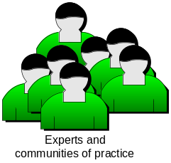
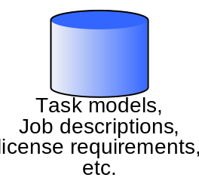
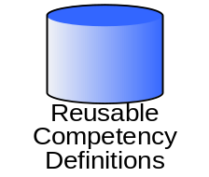

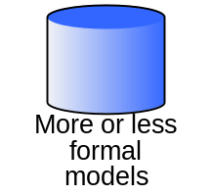
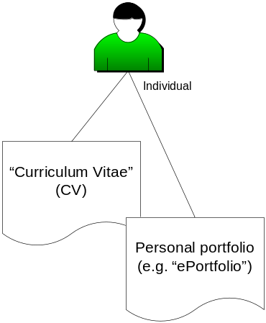
Ontologies and semantic modeling for competencies
Sources
Ontologies at
various levels of scope,
size, depth and quality

Slide 9
Ontologies and semantic modeling for competencies
Sources
Ontologies at
various levels of scope,
size, depth and quality
Lifecycle
Updates
Maintenance
Evolution
Semantic interoperability
Terminology issues

Slide 10

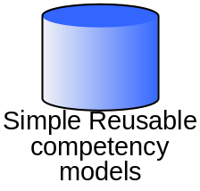
Ontologies and semantic modeling for competencies
Sources
Pragmatic
support for
different
applications
and domains
Ontologies at
various levels of scope,
size, depth and quality
Generate
Generate
Generate

Slide 11
Ontologies and semantic modeling for competencies
Sources
Pragmatic
support for
different
applications
and domains
Ontologies at
various levels of scope,
size, depth and quality
Generate
Generate
Generate

